Slide 1
Chapter 1- Introduction and Software Processes

Slide 2
Topics covered
Basic definition
Role of Management in Software Development
Software Products
Essential attributes of good software
Challenges for Software Engineering Practices
Software Engineering Diversity
Software Life Cycle
Software Process Model and its Types

Slide 3
1.1 Basic Definition
What is software?
Computer programs and associated documentation. Software products may be developed for a particular customer or may be developed for a general market.
What is software engineering?
Software engineering is an engineering discipline that is concerned with all aspects of software production from initial conception to operation and maintenance.
The IEEE [IEE17] has developed the following definition for software engineering:
The application of a systematic, disciplined, quantifiable approach to the development, operation, and maintenance of software; that is, the application of engineering to software.

Slide 4
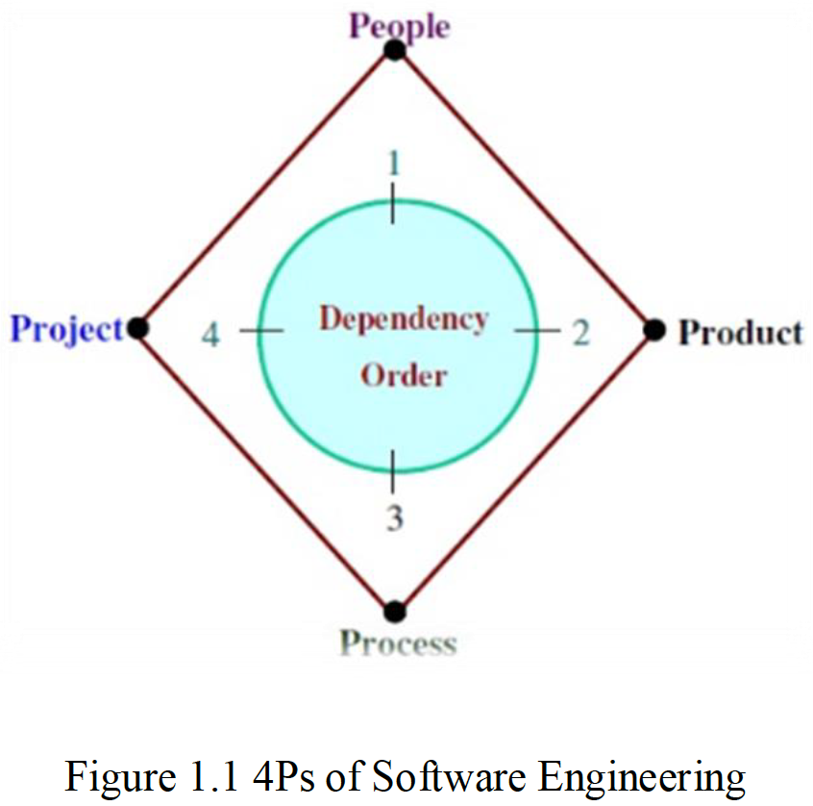
1.2 Role of Management in Software Development
Factor | Role
People | Software development requires good managers. The manager who can understand the psychology of the people and provide good leadership. After having a good manager, project is in safe hands. It is the responsibility of a manager to manage, motivate, encourage, guide and control the people of his/her team.
Product | What is delivered to the customer, is called a product. It may include source code, specification document, manuals, documentation etc. Basically, it is nothing but a set of deliverables only.
Process | Process is the way in which we produce software. It is the collection of activities that leads to (a part of) a product. An efficient process is required to produce good quality products. If the process is weak, the end product will undoubtedly suffer, but an obsessive over reliance on process is also dangerous.
Project | A proper planning is required to monitor the status of development and to control the complexity. Most of the projects are coming late with cost overruns of more than 100%. In order to manage a successful project, we must understand what can go wrong and how to do it wright.

Slide 5
1.3 Software products
Generic products
Stand-alone systems that are marketed and sold to any customer who wishes to buy them.
Examples – PC software such as graphics programs, project management tools; CAD software; software for specific markets such as appointments systems for dentists.
Customized products
Software that is commissioned by a specific customer to meet their own needs.
Examples – embedded control systems, air traffic control software, traffic monitoring systems.

Slide 6
1.4 Essential attributes of good software
Product characteristic | Description
Maintainability | Software should be written in such a way so that it can evolve to meet the changing needs of customers. This is a critical attribute because software change is an inevitable requirement of a changing business environment.
Dependability and security | Software dependability includes a range of characteristics including reliability, security and safety. Dependable software should not cause physical or economic damage in the event of system failure. Malicious users should not be able to access or damage the system.
Efficiency | Software should not make wasteful use of system resources such as memory and processor cycles. Efficiency therefore includes responsiveness, processing time, memory utilisation, etc.
Acceptability | Software must be acceptable to the type of users for which it is designed. This means that it must be understandable, usable and compatible with other systems that they use.

Slide 7
1.5 Challenges for Software Engineering Practices
Heterogeneity
Increasingly, systems are required to operate as distributed systems across networks that include different types of computer and mobile devices.
Business and social change
Business and society are changing incredibly quickly as emerging economies develop and new technologies become available. They need to be able to change their existing software and to rapidly develop new software.
Security and trust
As software is intertwined with all aspects of our lives, it is essential that we can trust that software.

Slide 8
1.6 Software Engineering Diversity
There are many different types of software system and there is no universal set of software techniques that is applicable to all of these. Rather, a diverse set of software engineering methods and tools has evolved.
The software engineering methods and tools used depend on the type of application being developed, the requirements of the customer and the background of the development team. There are many different types of application, including:
1. Stand-alone applications 5. Entertainment systems
2. Interactive transaction-based applications 6. Systems for modeling and simulation
3. Embedded control systems 7. Data collection systems
4. Batch processing systems 8. Systems of systems

Slide 9
Software Engineering Diversity : Application types
Stand-alone applications
These are application systems that run on a local computer, such as a PC. They include all necessary functionality and do not need to be connected to a network.
Interactive transaction-based applications
Applications that execute on a remote computer and are accessed by users from their own PCs or terminals. These include web applications such as e-commerce applications.
Embedded control systems
These are software control systems that control and manage hardware devices. Numerically, there are probably more embedded systems than any other type of system.
Batch processing systems
These are business systems that are designed to process data in large batches. They process large numbers of individual inputs to create corresponding outputs.

Slide 10
Software Engineering Diversity : Application types
Entertainment systems
These are systems that are primarily for personal use and which are intended to entertain the user.
Systems for modeling and simulation
These are systems that are developed by scientists and engineers to model physical processes or situations, which include many, separate, interacting objects.
Data collection systems
These are systems that collect data from their environment using a set of sensors and send that data to other systems for processing.
Systems of systems
These are systems that are composed of a number of other software systems.

Slide 11
1.7 Software Life cycle
The goal of Software Engineering is to provide models and processes that lead to the production of well-documented maintainable software in a manner that is predictable.
In the IEEE standard Glossary of Software Engineering Terminology, the software life cycle is: The period of time that starts when a software product is conceived and ends when the product is no longer available for use.
The software life cycle typically includes a requirement phase, design phase, implementation phase, test phase, installation and check out phase, operation and maintenance phase, and sometimes retirement phase”.
These activities involve the development of software from scratch until it is delivered to customers.

Slide 12
1.8 Software Process Model
Software process is defined as the structured set of activities that are required to develop the software system.
Many different software processes but all involve:
Specification – defining what the system should do;
Design and implementation – defining the organization of the system and implementing the system;
Validation – checking that it does what the customer wants;
Evolution – changing the system in response to changing customer needs.
A software process model is an abstract representation of a process. It presents a description of a process from some particular perspective.

Slide 13
1.9 Types of Software process models
There are many types of software process models that development teams use across different industries. Here are some examples of typical software process models you can use to outline your development process:
The waterfall model
Incremental development model
Reuse-oriented Model
Boehm’s Spiral Model
Agile methods

Slide 14
1.9.1The waterfall model
Waterfall model is the earliest software development life cycle (SDLC) approach that was used for software development. It is also referred to as a linear-sequential life cycle model. It is very simple to understand and use.
In a waterfall model, each phase must be completed before the next phase can begin and there is no overlapping in the phases. All phases are cascaded to each other in which progress is seen as flowing steadily downwards (like a waterfall) through the phases.
In Waterfall model, typically, the outcome of one phase acts as the input for the next phase sequentially. The next phase is started only after the defined set of goals are achieved for previous phase and it is signed off, so the name "Waterfall Model".

Slide 15
The waterfall model
Figure 1.2: Waterfall Model

Slide 16
Waterfall model phases
Phase | Description
Requirement Gathering and analysis | All possible requirements of the system to be developed are captured in this phase and documented in a requirement specification doc.
System Design | The requirement specifications from first phase are studied in this phase and system design is prepared. System Design helps in specifying hardware and system requirements and also helps in defining overall system architecture.
Implementation | With inputs from system design, the system is first developed in small programs called units, which are integrated (وحدات متكاملة) in the next phase. Each unit is developed and tested for its functionality which is referred to as Unit Testing.
Integration and Testing | All the units developed in the implementation phase are integrated into a system after testing of each unit. Post integration the entire system is tested for any faults and failures.
Deployment of system | Once the functional and non-functional testing is done, the product is deployed in the customer environment (تثبيت البرنامج للاستخدام) or released into the market.
Maintenance | There are some issues which come up in the client environment. To fix those issues patches are released. Also to enhance the product some better versions are released. Maintenance is done to deliver these changes in the customer environment.

Slide 17
1.9.2 Incremental Development Model
Incremental model uses the linear sequential approach with the iterative nature of prototyping. Incremental development is based on the idea of developing an initial implementation, delivering it to user for feedback and improving it through several versions of product releases until an acceptable system is developed.
In incremental model the whole requirement is divided into various builds.
During each iteration, the development module goes through the requirements, design, implementation and testing phase.
Each subsequent release of the module adds function to the previous release. The process continues till the complete system is ready as per the requirement.
The key to use of incremental development model successfully is rigorous validation of requirements, and verification of each version of the software against the requirements.

Slide 18
Incremental Development Model
Figure 1.3: Incremental Development Model

Slide 19
1.9.3 Reuse-oriented Model
The reuse-oriented development is where they reuse programming or software in previous projects or existing software components.
Reuse-oriented development is based on systematic reuse where systems are integrated from existing components.
This development can reduce the overall cost of software development and it can also save time because each phase of the process builds on the previous phase which has already been refined.
Figure1.4: Reuse-oriented software engineering

Slide 20
Reuse-oriented Model phases
Requirement Specification: All possible requirements of the system to be developed are captured in this phase.
2. Component Analysis: According to given requirement, component is selected to implement that requirement specification. That is not possible the selected component provide the complete functionality, but that is possible the component used provide some of the functionality required.
3. Requirement Modification: Information about component that is selected during component analysis is used to analysis requirement specification. Requirements are modified according to available components. Requirement modification is critical then component analysis activity is reused to find relative solution.
4. System design with reuse: During this stage the design of the system is build. Designer must consider the reused component and organize the framework. If reused component is not available then new software is develop.
5. Development and Integration: Components are integrated to develop new software. Integration in this model is part of development rather than separate activity.

Slide 21
1.9.4 Boehm’s Spiral Model
A risk-driven software process framework (the spiral model) was proposed by Boehm.
Process is represented as a spiral rather than as a sequence of activities with some backtracking from one activity to another.
Each loop in the spiral represents a phase in the process.
No fixed phases such as specification or design - loops in the spiral are chosen depending on what is required.
Risks are explicitly assessed and resolved throughout the process.

Slide 22
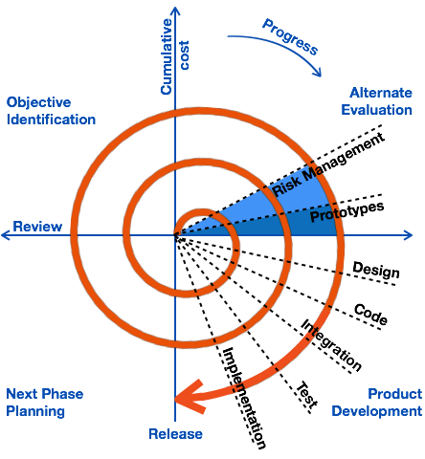
Boehm’s spiral model of the software process

Slide 23
Explanation of Spiral Model Activities
Activity | Description
Objective Identification | Requirements are gathered from the customers and the objectives are identified, elaborated, and analyzed. Project risks are identified. Alternative strategies, depending on these risks, may be planned.
Alternate Evaluation | In this quadrant, all the proposed solutions are analyzed and any potential risk is identified, analyzed, and resolved. The Prototype is built for the best possible solution.
Product development | The identified features are developed and verified through testing. At the end of the stage, the next version of the software is available.
Next Phase Planning | The project is reviewed and a decision made whether to continue with a further loop of the spiral. If it is decided to continue, plans are drawn up for the next phase of the project.

Slide 24
1.9.5 Agile methods
Agile model is a combination of iterative and incremental process models with focus on process adaptability and customer satisfaction by rapid delivery of working software product.
Agile Methods break the product into small incremental builds. These builds are provided in iterations. At the end of each iteration a working product is displayed to the customer.
In Agile development less time is spent on planning and more focus on the features need to be developed. There is feature driven development and the team adapts to the changing product requirements dynamically. The product is tested very frequently, through the release iterations, minimizing the risk of any major failures in future.
.

Slide 25
Agile methods
Figure 2.5: Graphical Illustration of the Agile Methods

Slide 26
1.9.6 Comparison of Different Software Process Models
Process model | Approach | Advantages | Disadvantages | When to Apply
Waterfall | Linear sequential | Clear documentation, easy to manage | Inflexible, limited feedback, high risk | Simple, small projects with clear requirements
Incremental | Linear Sequential with Iterative | Easier to test and debug, more flexible, simple to manage risk. | Can be time-consuming, expensive, requires a high level of collaboration | Projects with changing requirements
Reuse-oriented | Reuse-based | Reduce total cost, low risk factor, save lots of time and effort. | Requires well-defined components, may not fit all projects | Projects that necessitate a high level of flexibility, scalability, maintainability
Spiral | Iterative, risk-driven | Highlights risk management, flexible, adaptive | Time-consuming, can be expensive | Large, complex, high-risk projects
Agile | Iterative | Flexible, adaptive, continuous feedback | Requires active user involvement, can be chaotic | Complex projects with fluctuating requirements

Slide 27
Key points
Software engineering is an engineering discipline that is concerned with all aspects of software production.
Essential software product attributes are maintainability, dependability and security, efficiency and acceptability.
The high-level activities of specification, development, validation and evolution are part of all software processes.
There are many different types of system and each requires appropriate software engineering tools and techniques for their development.
Software processes are the activities involved in producing a software system. Software process models are abstract representations of these processes.

Slide 28
Key points
General process models describe the organization of software processes. Examples of these general models include the ‘waterfall’ model, incremental development, and reuse-oriented development.
The spiral model is a systems development lifecycle (SDLC) method used for risk management that combines the iterative development process model with elements of the Waterfall model.
Agile methods are incremental development methods that focus on rapid development, frequent releases of the software, reducing process overheads and producing high-quality code. They involve the customer directly in the development process.

Slide 29
Review Questions
Define: Software, Software Engineering, Software life cycle, Software process.
What are the 4P’s of Software Engineering?
Differentiate between Generic product and Customized product.
What are the essential attributes of good software?
List down the challenges of software engineering practices, activities of Software process.
Explain in detail: Waterfall Model, Incremental development model, Reuse-oriented model, Boehm's spiral model, Agile method. What are the Advantages and Disadvantages?

Slide 30
Chapter 2 – Requirements Engineering

Slide 31
Topics covered
Requirement Engineering
Crucial Process Steps of Requirement Engineering
Types of Requirements
User and System Requirements
Categories of Metrics
Software Requirements Specification (SRS) Document
Requirements Gathering Techniques

Slide 32
2.1 Requirements Engineering
The process of establishing the services that the customer requires from a system and the constraints under which it operates and is developed.
The requirements themselves are the descriptions of the system services and constraints that are generated during the requirements engineering process.
Requirements engineering is one of the most crucial activity in this creation process. Without well-written requirements specifications, developers do not know what to build, customers do not know what to expect, and there is no way to validate that the built system satisfies the requirements.

Slide 33
2.2 Crucial Process Steps of Requirement Engineering
The requirements engineering consists of four steps
The primary output of requirements engineering is requirements specifications. If it describes both hardware and software, it is a system requirements specifications. If it describes only software, it is a software requirements specifications.
Process Step | Description
Requirements elicitation | This is also known as gathering of requirements. Here requirements are identified with the help of customer and existing systems process if available.
Requirements analysis | The requirements are analyzed in order to identify inconsistencies, defects, omissions, and also resolve conflicts if any.
Requirements documentations | It is the foundation for the design of the software. The document is known as software requirements specification (SRS).
Requirements review | The review process is carried out to improve the quality of the SRS.

Slide 34
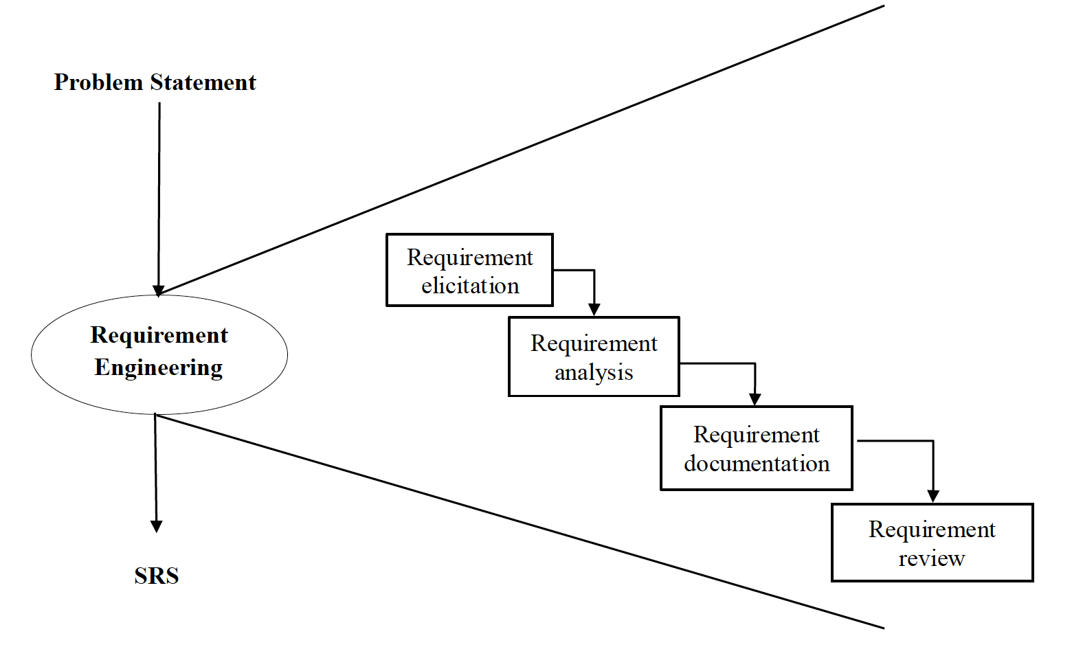
Crucial Process Steps of Requirement Engineering
Figure 2.1: Crucial Process Steps of Requirement Engineering

Slide 35
2.3 Types of Requirements
Functional requirements
Statements of services the system should provide, how the system should react to particular inputs and how the system should behave in particular situations.
May state what the system should not do.
Non-functional requirements
Constraints on the services or functions offered by the system such as timing constraints, constraints on the development process, standards, etc.
Often apply to the system as a whole rather than individual features or services.

Slide 36
Functional Requirements
Describe functionality or system services.
Depend on the type of software, expected users and the type of system where the software is used.
Functional user requirements may be high-level statements of what the system should do.
Functional system requirements should describe the system services in detail.

Slide 37
Non-Functional Requirements
These define system properties and constraints e.g. reliability, response time and storage requirements. Constraints are I/O device capability, system representations, etc.
Process requirements may also be specified mandating a particular IDE, programming language or development method.
Non-functional requirements may be more critical than functional requirements. If these are not met, the system may be useless.

Slide 38
Non-Functional Classifications
Figure 2.2: Types of Non-Functional Requirement

Slide 39
Non-Functional Classifications
Product requirements
Requirements which specify that the delivered product must behave in a particular way e.g. execution speed, reliability, etc.
Organisational requirements
Requirements which are a consequence of organisational policies and procedures e.g. process standards used, implementation requirements, etc.
External requirements
Requirements which arise from factors which are external to the system and its development process e.g. interoperability requirements, legislative requirements, etc.

Slide 40
2.4 User and System Requirements
User requirement are written for the users and include functional and non-functional requirement. User requirements should specify the external behavior of the system with some constraints and quality parameters.
System requirement are derived from user requirement. They are expanded form of user requirements.
A measure provides a quantitative indication of the extent, amount, dimension, capacity, or size of some attribute of the product or process”.
Measurement is the act of determine a measure.
The metric is a quantitative measure of the degree to which a system, component, or process possesses a given attribute.

Slide 41
2.5 Categories of Metrics
Product metrics: describe the characteristics of the product such as size, complexity, design features, performance, efficiency, reliability, portability, etc.
Property | Measure
Speed | Processed transactions/second User/event response time Screen refresh time
Size | Mbytes Number of ROM chips
Ease of use | Training time Number of help frames
Reliability | Mean time to failure Probability of unavailability Rate of failure occurrence Availability
Robustness | Time to restart after failure Percentage of events causing failure Probability of data corruption on failure
Portability | Percentage of target dependent statements Number of target systems

Slide 42
Categories of Metrics
Process metrics: describe the effectiveness and quality of the processes that produce the Software product. Examples are:
Effort required in the process
Time to produce the product
Effectiveness of defect removal during development
Number of defects found during testing
Maturity of the process
Project metrics: describe the project characteristics and execution. Examples are:
Number of software developers
Staffing pattern over the life cycle of the software
Cost and schedule
Productivity

Slide 43
2.6 Software Requirements Specification (SRS) Document
The SRS is a specification for a particular s/w product, program, or set of programs that performs certain functions in a specific environment.
The SRS serve as contract document between customer and developer. SRS reduces the probability of the customer being disappointed with the final product.
Nature of the SRS: The basic issues of that SRS writer(s) shall address the following:
Functionality
External interface
Performance
Attributes
Design constraints imposed on an implementation

Slide 44
Characteristics of a Good SRS
The SRS should be:
Correct
Unambiguous
Complete
Consistent
Rank for importance and/ stability
Verifiable
Modifiable
Traceable

Slide 45
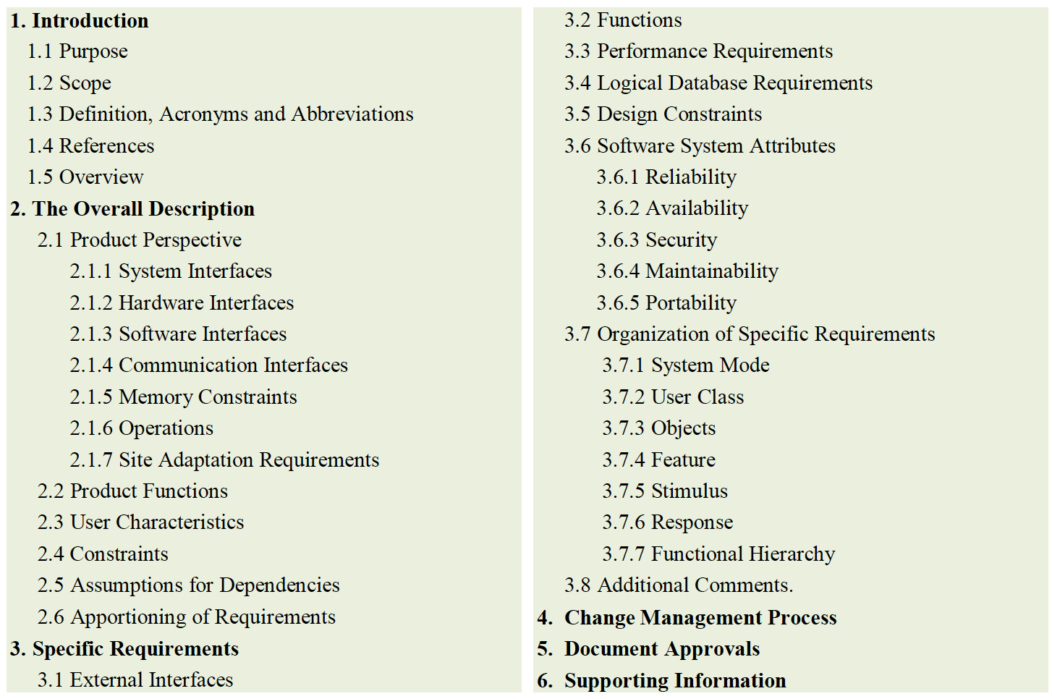
Organization of the SRS
The (IEEE) has published guidelines and standards to organize an SRS document.
Different projects may require their requirements to be organized differently but still first two sections of the SRS are the same in all of them.
The template to organize and draft the SRS for any project.

Slide 46
2.7 Requirements Gathering Techniques
Some requirements gathering techniques may be beneficial in one project but may not be in other.
The usefulness of a technique is determined by its need and the kind of advantages.
Following are some popular requirements gathering techniques:

Slide 47

Brainstorming
Description
Brainstorming is human nature to solve any problem as an early thought process. It can be utilized to gather a good number of ideas from a group of people by sharing ideas to identify all possible solutions.

Slide 48

Document Analysis
Description
Usually followed where a system is already in place, so evaluating the documentation of a present system can assist to gather requirements for updating or replacing existing system.

Slide 49

Focus Group
Description
A focus group is a gathering of people who are customers or user representatives for a product to gain its feedback. The feedback can be collected about opportunities, needs, and problems to determine requirements or it can be collected to refine and validate the already elicited requirements.

Slide 50
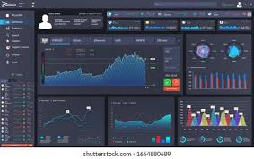
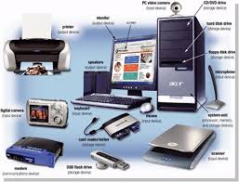
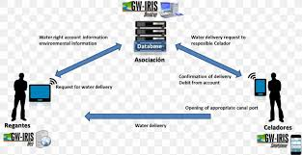
Interface Analysis
Description
Interface for any software product are either be human or machine. Integration with external devices and systems is another interface. The user-centric design approaches are quite effective to collect and develop usable software.

Slide 51

Interview
Description
Interviews of users and stakeholders are important in creating wonderful software. Without knowing the expectations and goal of the stakeholders and users it is impossible to satisfy them. To understand the perspective of every interviewee it is important to properly collect their inputs. Like a good reporter, listening is a quality that assists an excellent analyst to gain better value through an interview.

Slide 52
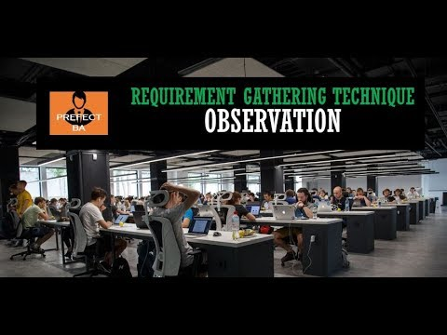
Observation
Description
The observation covers the study of users in their workplace. By watching users, a process flow, pain points, awkward steps and opportunities can be determined by an analyst for improvement. Observation can either be passive or active. Passive observation provides better feedback to refine requirements on the same hand active observation works best for obtaining an understanding over an existing business process.

Slide 53
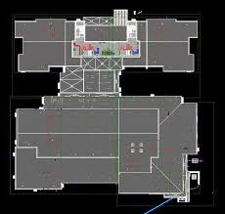
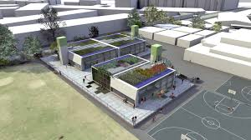
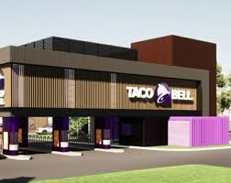
Prototyping
Description
Prototyping can be very helpful at gathering feedback. Low fidelity prototypes make a good listening tool. Many a times, people are not able to articulate a specific need in the abstract. They can swiftly review whether a design approach would satisfy their need. Prototypes are very effectively done with fast sketches of storyboards and interfaces.

Slide 54
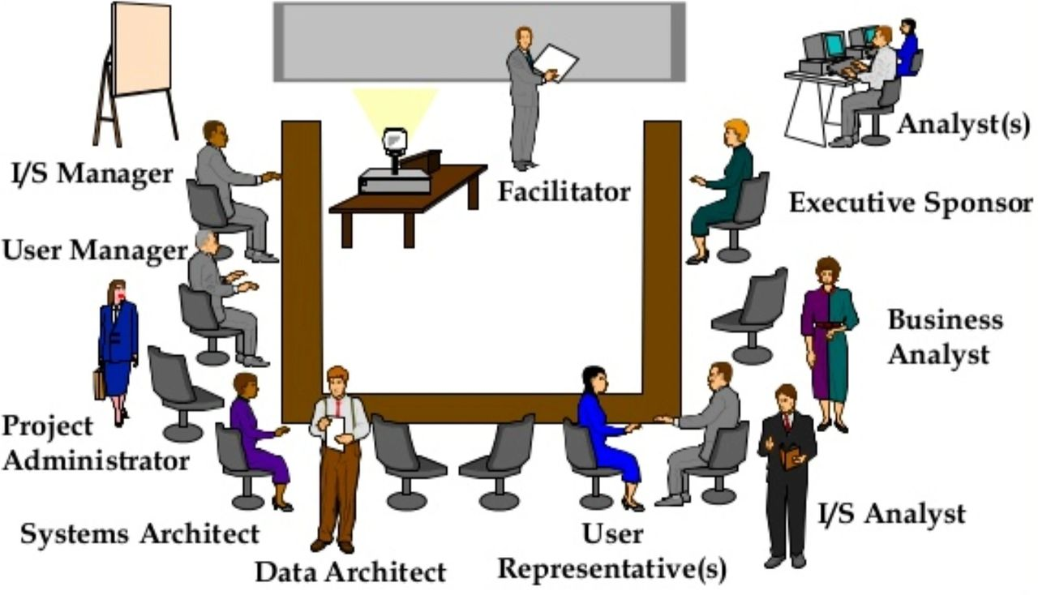
Requirements Workshop
Description
Popularly known as JAD or joint application design, these workshops can be efficient for gathering requirements. The requirements workshops are more organized and structured than a brainstorming session where the involved parties get together to document requirements.

Slide 55
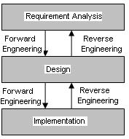
Reverse Engineering
Description
When a legacy project does not have enough documentation, reverse engineering can determine what system does? It do not determine what features went wrong with the system and what a system must do.

Slide 56
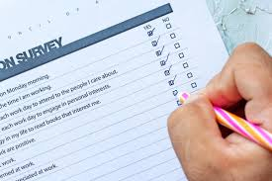
Survey
Description
When gathering information from many people: too many to interview with time constraints and less budget: a questionnaire survey can be used. The survey insists the users to choose from the given options agree / disagree or rate something.

Slide 57
Key points
Requirements for a software system set out what the system should do and define constraints on its operation and implementation.
Functional requirements are statements of the services that the system must provide or are descriptions of how some computations must be carried out.
Non-functional requirements often constrain the system being developed and the development process being used.
They often relate to the emergent properties of the system and therefore apply to the system as a whole.

Slide 58
Review Questions
Define: requirements engineering, measure, measurement, metrics, SRS
Illustrate crucial process steps of requirement engineering with neat diagram
Differentiate Functional and Non-functional Requirements
Explain different classifications of Non-functional requirements
What are the different categories of metrics?
What are the basic issues addressed by SRS writers
List down the characteristics of good SRS
Explain various requirement gathering techniques.

Slide 59
Chapter 3 – System Modeling and Architectural Design

Slide 60
Topics covered
System Modeling
UML Diagram Types
Graphical Models
Software Architecture
Architectural Design
Architectural Views
Application Architectures
Transaction Processing Systems

Slide 61
3.1 System Modeling
System modeling is the process of developing abstract models of a system, with each model presenting a different view or perspective of that system.
System modeling has now come to mean representing a system using some kind of graphical notation, which is now almost always based on notations in the Unified Modeling Language (UML).
System modelling helps the analyst to understand the functionality of the system and models are used to communicate with customers.

Slide 62
3.2 UML Diagram Types
Activity diagrams, which show the activities involved in a process or in data processing .
Use case diagrams, which show the interactions between a system and its environment.
Sequence diagrams, which show interactions between actors and the system and between system components.
Class diagrams, which show the object classes in the system and the associations between these classes.
State diagrams, which show how the system reacts to internal and external events.

Slide 63
3.3 Graphical Models
Context Model: in this model, context diagram and activity diagram is used.
Interaction Model: in this model, use-case diagram and sequence diagram is used.
Structural Model: in this model, class diagram and object diagram is used.

Slide 64
3.3.1 Context Models
Context models are used to illustrate the operational context of a system - they show what lies outside the system boundaries.
Social and organisational concerns may affect the decision on where to position system boundaries.
Architectural models show the system and its relationship with other systems.

Slide 65
Context Diagram {Not UML Diagram} for Android Blood-Bank and its Boundaries
Figure 3.1: Context Diagram for Android Blood-Bank and its Boundaries

Slide 66
Context Models
Activity diagrams are intended to show the activities that make up a system process and the flow of control from one activity to another.
The start of a process is indicated by a filled circle; the end by a filled circle inside another circle.
Rectangles with round corners represent activities, that is, the specific sub-processes that must be carried out.
You may include objects in activity charts.
UML activity diagrams are used to define major business process models.

Slide 67
UML Activity Diagram for Inventory System
Figure 3.2: UML Activity Diagram for Inventory System

Slide 68
3.3.2 Interaction Models
Modeling user interaction is important as it helps to identify user requirements.
Modeling system-to-system interaction highlights the communication problems that may arise.
Modeling component interaction helps us understand if a proposed system structure is likely to deliver the required system performance and dependability.
Use case diagrams and sequence diagrams may be used for interaction modeling.

Slide 69
Use Case Modeling
Use cases were developed originally to support requirements elicitation and now incorporated into the UML.
Each use case represents a discrete task that involves external interaction with a system.
Actors in a use case may be people or other systems.
Use case diagrams give a fairly simple overview of an interaction so you have to provide more detail to understand what is involved. This detail can either be a simple textual description, a structured description in a table, or a sequence diagram.

Slide 70
Use-Case Diagram for ATM
Figure 3.3: Use-Case Diagram for ATM

Slide 71
Sequence Diagrams
Sequence diagrams are part of the UML and are used to model the interactions between the actors and the objects within a system.
A sequence diagram shows the sequence of interactions that take place during a particular use case or use case instance.
The objects and actors involved are listed along the top of the diagram, with a dotted line drawn vertically from these.
Interactions between objects are indicated by annotated arrows.

Slide 72
Sequence Diagram for ATM
Figure 3.4: Sequence Diagram for ATM

Slide 73
3.3.3 Structural Models
Structural models of software display the organization of a system in terms of the components that make up that system and their relationships.
Structural models may be static models, which show the structure of the system design, or dynamic models, which show the organization of the system when it is executing.
You create structural models of a system when you are discussing and designing the system architecture.

Slide 74
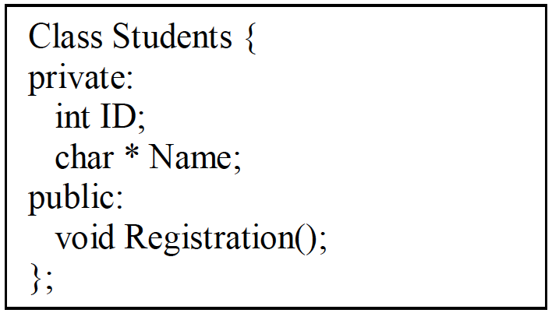
Class Diagrams
Class diagrams are used when developing an object-oriented system model to show the classes in a system and the associations between these classes.
Class diagram is an illustration of the relationships and source code dependencies among classes in the Unified Modeling Language (UML).
Class Diagram Notations: UML class is represented by the diagram shown below that is divided into three sections.
First section is used to name the class.
Second section is used to show the
attributes / member variable of the class.
Third section is used to describe the
operations performed by the class.

Slide 75
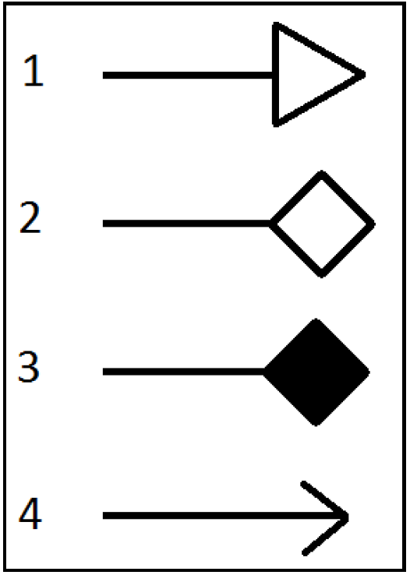
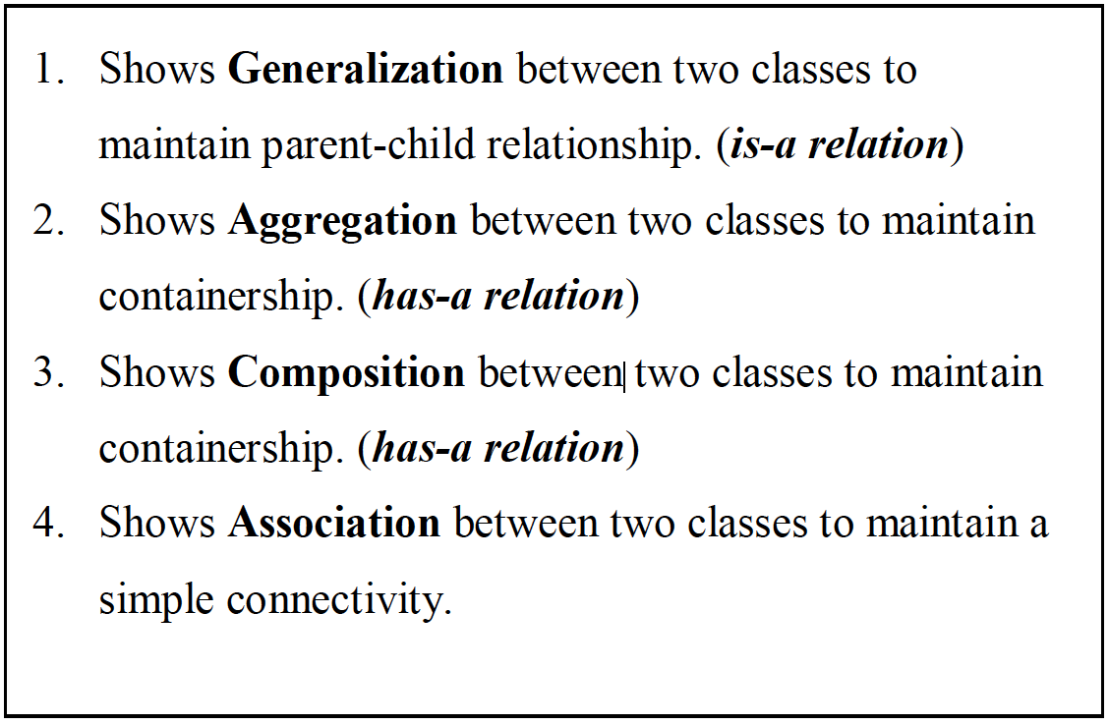
Types of Relationship Between the Classes

Slide 76
Types of Relationship Between the Classes
Difference between Aggregation and Composition: (Has-a Relationship)
In aggregation contained class exist even if main class is deleted. Eg: Car has Engine, If car is broken still engine exist and can be used in another car.
In composition contained class live or die on the basis of main class. Eg: Folder has file, If you delete a folder all files will be deleted as well.
Generalization: (Is-a Relationship)
Generalization is used in class diagrams to deal with most powerful concept of object orientation that is Inheritance. Generalization is drawn between two classes to show Parent-Child relation.
In modeling systems, it is often useful to examine the classes in a system to see if there is scope for generalization. If changes are proposed, then you do not have to look at all classes in the system to see if they are affected by the change.
The lower-level classes are subclasses that inherit the attributes and operations from their superclass. These lower-level classes then add more specific attributes and operations.

Slide 77
Class Diagram Showing Different Type of Relationships
Figure3.5: Class Diagram Showing Different Type of Relationships

Slide 78
3.4 Architectural Design
Architectural design is concerned with understanding how a software system should be organized and designing the overall structure of that system
Architectural design is the first stage in the software design process.
It is the critical link between design and requirements engineering, as it identifies the main structural components in a system and the relationships between them.
.The output of the architectural design process is an architectural model that describes how the system is organized as a set of communicating components.

Slide 79
3.4.1 Use of Architectural Models
As a way of facilitating discussion about the system design
A high-level architectural view of a system is useful for communication with system stakeholders and project planning because it is not cluttered with detail. Stakeholders can relate to it and understand an abstract view of the system. They can then discuss the system as a whole without being confused by detail.
As a way of documenting an architecture that has been designed
The aim here is to produce a complete system model that shows the different components in a system, their interfaces and their connections.

Slide 80
3.5 Architectural Views
Each architectural model only shows one view or perspective of the system.
It might show how a system is decomposed into modules, how the run-time processes interact or the different ways in which system components are distributed across a network. For both design and documentation, you usually need to present multiple views of the software architecture.
Krutchen in his well-known 4 +1 view model of software architecture, suggests that there should be four fundamental architectural views, which can be linked through common use cases or scenarios (shown in Fig: 3.6 – Next slide)

Slide 81
4 + 1 View Model of Software Architecture
Figure 3.6: 4+1 View Model

Slide 82
4 + 1 View Model of Software Architecture
A logical view, which shows the key abstractions in the system as objects or object classes.
A process view, which shows how, at run-time, the system is composed of interacting processes.
A development view, which shows how the software is decomposed for development.
A physical view, which shows the system hardware and how software components are distributed across the processors in the system.
Related using use cases or scenarios (+1)

Slide 83
3.6 Application Architectures
Application systems are designed to meet an organizational need.
As businesses have much in common, their application systems also tend to have a common architecture that reflects the application requirements.
Use of Application Architectures
As a starting point for architectural design.
As a design checklist.
As a way of organizing the work of the development team.
As a means of assessing components for reuse.
As a vocabulary for talking about application types.

Slide 84
3.7 Transaction Processing Systems (TPS)
TPS is a type of information system that collects, stores, modifies and retrieves the data transactions of an organization.
For example - airline reservation systems, electronic transfer of funds, bank account processing systems.
From a user perspective a transaction is:
Any coherent sequence of operations that satisfies a goal;
For example - find the times of flights from London to Paris.
Users make asynchronous requests for service which are then processed by a transaction manager.

Slide 85
3.7.1 Application Architecture of TPS
Transaction processing systems are usually interactive systems in which users make asynchronous requests for service.
Asynchronous means that you do not halt all other operations while waiting for the web service call to return.
Figure 5.2 illustrates the conceptual architectural structure of TPS.
First a user makes a request to the system through an I/O processing component. The request is processed by some application specific logic. A transaction is created and passed to a transaction manager, which is usually embedded in the database management system. After the transaction manager has ensured that the transaction is properly completed, it signals to the application that processing has finished.
Figure 3.7: Architecture of TPS

Slide 86
3.7.2 The Software Architecture of an ATM System
An example of a transaction is a customer request to withdraw money from a bank account using an ATM, Figure 5.3. This involves getting details of the customer’s account, checking the balance, modifying the balance by the amount withdrawn, and sending commands to the ATM to deliver the cash. Until all of these steps have been completed, the transaction is incomplete and the customer accounts database is not changed.
Figure 3.8: Architecture of ATM

Slide 87
Key Points
A model is an abstract view of a system that ignores system details. Complementary system models can be developed to show the system’s context, interactions, structure and behavior.
Context models show how a system that is being modeled is positioned in an environment with other systems and processes.
Use case diagrams and sequence diagrams are used to describe the interactions between users and systems in the system being designed. Use cases describe interactions between a system and external actors; sequence diagrams add more information to these by showing interactions between system objects.
Structural models show the organization and architecture of a system. Class diagrams are used to define the static structure of classes in a system and their associations.

Slide 88
Key Points
A software architecture is a description of how a software system is organized.
Architectural design decisions include decisions on the type of application, the distribution of the system, the architectural styles to be used.
Architectures may be documented from several different perspectives or views such as a conceptual view, a logical view, a process view, and a development view.
TPS is a type of information system that collects, stores, modifies and retrieves the data transactions of an organization.

Slide 89
Review questions
Define: system modeling, Activity diagram, Use case diagram, sequence diagram, class diagram, state diagram
Explain various graphical models
Draw Use-case and Sequence diagram for ATM
Difference between Aggregation and Composition.
What is Architectural design? What are the uses of architectural model?
Illustrate 4+1 view model of software architecture with neat diagram
List down the uses of application architecture.
What is TPS? Explain application architecture of TPS with neat diagram.

Slide 90
Chapter 4 – Design and Implementation

Slide 91
Topics Covered
Design and Implementation
An Object-Oriented Design Process
Context and Interaction Models
Implementation Issues
Open Source Development

Slide 92
4.1 Design and Implementation
Software design and implementation is the stage in the software engineering process at which an executable software system is developed.
Software design and implementation activities are invariably inter-leaved.
Software design is a creative activity in which you identify software components and their relationships, based on a customer’s requirements.
Implementation is the process of realizing the design as a program.

Slide 93
4.2 An Object-Oriented Design Process
Structured object-oriented design processes involve developing a number of different system models.
They require a lot of effort for development and maintenance of these models and, for small systems, this may not be cost-effective.
However, for large systems developed by different groups design models are an important communication mechanism.

Slide 94
Process Stages
There are a variety of different object-oriented design processes that depend on the organization using the process.
Common activities in these processes include:
Define the context and modes of use of the system;
Design the system architecture;
Identify the principal system objects;
Develop design models;
Specify object interfaces.

Slide 95
4.3 Context and Interaction Models
A system context model is a structural model that demonstrates the other systems in the environment of the system being developed.
An interaction model is a dynamic model that shows how the system interacts with its environment as it is used.

Slide 96
4.4 Implementation Issues
Software engineering includes all of the activities involved in software development from the initial requirements of the system through to maintenance and management of the deployed system. A critical stage of this process is, of course, system implementation, where you create an executable version of the software.
Implementation may involve developing programs in high- or low-level programming languages or tailoring and adapting generic, off-the-shelf systems to meet the specific requirements of an organization.

Slide 97
Implementation Issues
Focus here is not on programming, although this is obviously important, but on other implementation issues that are often not covered in programming texts:
Reuse Most modern software is constructed by reusing existing components or systems. When you are developing software, you should make as much use as possible of existing code.
Configuration management During the development process, you have to keep track of the many different versions of each software component in a configuration management system.
Host-target development Production software does not usually execute on the same computer as the software development environment. Rather, you develop it on one computer (the host system) and execute it on a separate computer (the target system).

Slide 98
4.4.1 Reuse
From the 1960s to the 1990s, most new software was developed from scratch, by writing all code in a high-level programming language.
The only significant reuse or software was the reuse of functions and objects in programming language libraries.
Costs and schedule pressure mean that this approach became increasingly unviable, especially for commercial and Internet-based systems.
An approach to development based around the reuse of existing software emerged and is now generally used for business and scientific software.

Slide 99
Reuse Levels
The abstraction level
At this level, you don’t reuse software directly but use knowledge of successful abstractions in the design of your software.
The object level
At this level, you directly reuse objects from a library rather than writing the code yourself.
The component level
Components are collections of objects and object classes that you reuse in application systems.
The system level
At this level, you reuse entire application systems.

Slide 100
4.4.2 Configuration Management
Configuration management is the name given to the general process of managing a changing software system.
The aim of configuration management is to support the system integration process so that all developers can access the project code and documents in a controlled way, find out what changes have been made, and compile and link components to create a system.

Slide 101
Configuration Management Activities
Version management, where support is provided to keep track of the different versions of software components. Version management systems include facilities to coordinate development by several programmers.
System integration, where support is provided to help developers define what versions of components are used to create each version of a system. This description is then used to build a system automatically by compiling and linking the required components.
Problem tracking, where support is provided to allow users to report bugs and other problems, and to allow all developers to see who is working on these problems and when they are fixed.

Slide 102
4.4.3 Host-Target Development
Most software is developed on one computer (the host), but runs on a separate machine (the target).
More generally, we can talk about a development platform and an execution platform.
A platform is more than just hardware.
It includes the installed operating system plus other supporting software such as a database management system or, for development platforms, an interactive development environment.
Development platform usually has different installed software than execution platform; these platforms may have different architectures.

Slide 103
4.5 Open Source Development
Open source development is an approach to software development in which the source code of a software system is published and volunteers are invited to participate in the development process
Its roots are in the Free Software Foundation (www.fsf.org), which advocates that source code should not be proprietary but rather should always be available for users to examine and modify as they wish.
Open source software extended this idea by using the Internet to recruit a much larger population of volunteer developers. Many of them are also users of the code.

Slide 104
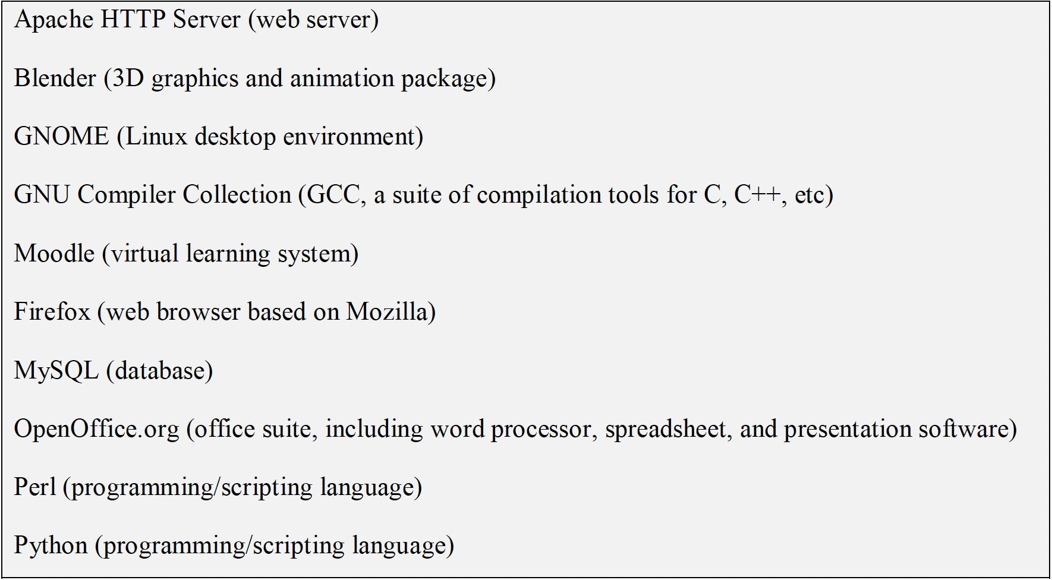
4.5.1 Open Source Systems
The best-known open source product is, of course, the Linux operating system which is widely used as a server system and, increasingly, as a desktop environment.
Other important open source products are Java, the Apache web server and the mySQL database management system.

Slide 105
4.5.2 Open Source Business
More and more product companies are using an open source approach to development.
Their business model is not reliant on selling a software product but on selling support for that product.
They believe that involving the open source community will allow software to be developed more cheaply, more quickly and will create a community of users for the software.

Slide 106
4.5.3 Open Source Licensing
A fundamental principle of open-source development is that source code should be freely available, this does not mean that anyone can do as they wish with that code.
Legally, the developer of the code (either a company or an individual) still owns the code. They can place restrictions on how it is used by including legally binding conditions in an open source software license.
Some open source developers believe that if an open source component is used to develop a new system, then that system should also be open source.
Others are willing to allow their code to be used without this restriction. The developed systems may be proprietary and sold as closed source systems.

Slide 107
Key Points
Software design and implementation are inter-leaved activities. The level of detail in the design depends on the type of system and whether you are using a plan-driven or agile approach.
The process of object-oriented design includes activities to design the system architecture, identify objects in the system, describe the design using different object models and document the component interfaces.
A range of different models may be produced during an object-oriented design process. These include static models (class models, generalization models, association models) and dynamic models (sequence models, state machine models).
Component interfaces must be defined precisely so that other objects can use them. A UML interface stereotype may be used to define interfaces.

Slide 108
Key Points
When developing software, you should always consider the possibility of reusing existing software, either as components, services or complete systems.
Configuration management is the process of managing changes to an evolving software system. It is essential when a team of people are cooperating to develop software.
Most software development is host-target development. You use an IDE on a host machine to develop the software, which is transferred to a target machine for execution.
Open source development involves making the source code of a system publicly available. This means that many people can propose changes and improvements to the software.

Slide 109
Review questions
Write short notes on Object-Oriented Design Process. List its common activities.
Define: system context model and interaction
List and explain various implementation issues.
What are the different levels of software reuse
What is meant by configuration management? List down its activities.
Write short notes on Host-target development.
Write briefly about open source development system.

Slide 110
Chapter 5 – Software Testing and Maintenance

Slide 111
Topics Covered
Software verification and validation
Software Testing
Stages of Testing
Black Box Testing (BBT)
White Box Testing (WBT)
Software Maintenance and its types
The Software Maintenance Process
Maintenance Costs and Prediction
Software RE-Engineering

Slide 112
5.1 Software Verification and Validation
Verification and validation are the processes in which we check a product against its specifications and the expectations of the users who will be using it.
Verification: "Are we building the product right”
“Does the product meet system specifications?”
Validation: "Are we building the right product”
“Does the product meet user expectations?”
Figure 7.1: Scope of V & V in software engineering

Slide 113
5.2 Software Testing
Testing is the process of executing a program with the intent of finding errors.
“Testing can reveal the presence of errors NOT their absence”
5.2.1 Why should we Test?
Software testing is an expensive activity but launching of software without testing may lead to cost much higher than the cost of testing itself.
Testing assure to developers and customers that the software meets its requirements.
It discovers the situations where behavior of the software is incorrect, undesirable or does not match to its specification.
Testing identifies undesirable system behavior such as system crashes, unwanted interactions with other systems, incorrect computations and data corruption.

Slide 114
5.2.2 Who should do the Testing?
Testing requires the developers to find errors from their software.
It is difficult for software developer to point out errors from own creations.
Many organizations have made a distinction between development and testing phase by making different people responsible for each phase.
5.2.3 What should we Test?
We should test the program’s responses to every possible input. It means, we should test for all valid and invalid inputs.
A strategy should develop test cases for the testing of small portion of program and also test cases for complete system or function.

Slide 115
5.3 Stages of Testing
Development testing, where the system is tested during development to discover bugs and defects.
Release testing, where a separate testing team test a complete version of the system before it is released to users.
User testing, where users or potential users of a system test the system in their own environment.

Slide 116
5.3.1 Development Testing
Development testing includes all testing activities that are carried out by the team developing the system.
Unit testing, where individual program units or object classes are tested. Unit testing should focus on testing the functionality of objects or methods.
Component testing, where several individual units are integrated to create composite components. Component testing should focus on testing component interfaces.
System testing, where some or all of the components in a system are integrated and the system is tested as a whole. System testing should focus on testing component interactions.
One of the popular development testing techniques is White Box Testing (WBT) that can be applied at the unit, integration and system levels of the testing process. (WBT is discussed separately)

Slide 117
5.3.2 Release Testing
Release testing is the process of testing a particular release of a system that is intended for use outside of the development team.
The primary goal of the release testing process is to convince the supplier of the system that it is good enough for use.
Release testing shows that the system delivers its specified functionality, performance and dependability, and that it does not fail during normal use.
Release testing is usually a Black Box Testing (BBT) process where tests are only derived from the system specification. (BBT is discussed separately)

Slide 118
5.3.3 User Testing
User or customer testing is a stage in the testing process in which users or customers provide input and advice on system testing.
Types of User Testing
Alpha testing
Users of the software work with the development team to test the software at the developer’s site.
Beta testing
A release of the software is made available to users to allow them to experiment and to raise problems that they discover with the system developers.
Acceptance testing
Customers test a system to decide whether or not it is ready to be accepted from the system developers and deployed in the customer environment. Primarily for custom (be-spoke) systems.

Slide 119
5.4 Black Box Testing (BBT)
Black-box testing, also called behavioral testing, focuses on the functional requirements of the software.
BBT enables the software engineer to derive sets of input conditions that will fully exercise all functional requirements for a program.
As shown in Figure7.2 (next slide) BBT is concerned only with the possible inputs and their desired output regardless of the developmental details.
BBT is performed by a separate testing team not the developer their self hence it is one type of release testing.

Slide 120
Black Box Testing (BBT)
There are further many types of BBT but two of the most commonly used types are as follows:
Equivalence Partitioning
Boundary Value Analysis

Slide 121
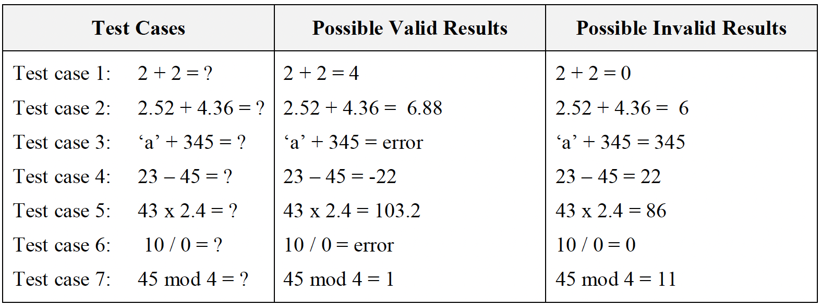
Equivalence Partitioning
Equivalence partitioning is a black-box testing method that divides the input domain of a program into classes of data from which test cases can be derived.
Examples: If a code of calculator has to test using BBT then possible partitioning of input test data are:

Slide 122
Boundary Value Analysis
Boundary value analysis enhances the performance of equivalence partitioning because it leads to the selection of test cases at the "edges" of the class.
Examples: In boundary value analysis testing test cases are generated as shown in Figure 7.3
Figure 7.3: Boundary Value Analysis ranges

Slide 123
5.5 White Box Testing (WBT)
White-box testing also called glass-box testing. In WBT test cases are designed using the control structure of the procedural design. Using white-box testing, software engineers can derive test cases that:
Guarantee that all independent paths within a module have been exercised at least once.
Exercise all logical decisions on their true and false sides
Execute all loops at their boundaries and within their operational bounds
Exercise internal data structures to ensure their validity.

Slide 124
White Box Testing (WBT)
WBT can be applied at any level of development testing.
In WBT at first code is converted into descriptive code by assigning the numbers against each significant step in the code.
Then using the Cyclomatic complexity correctness of the program can be assured.
Cyclomatic complexity: is a useful metric for predicting those modules that are likely to be error prone. It can be used for test planning as well as test case design.

Slide 125
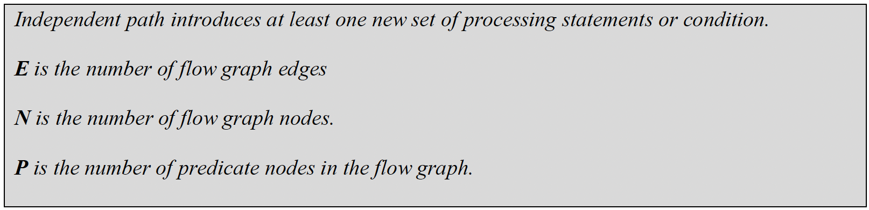
Methods used in WBT
Cyclomatic complexity: corresponds to number of regions of the flow graph or possible independent paths.
Cyclomatic complexity: V(G), for a flow graph, is defined as V(G) = E - N + 2
Cyclomatic complexity, V(G), for a flow graph, is also defined as V(G) = P + 1

Slide 126
Methods used in WBT
Flow Graph construction:

Slide 127
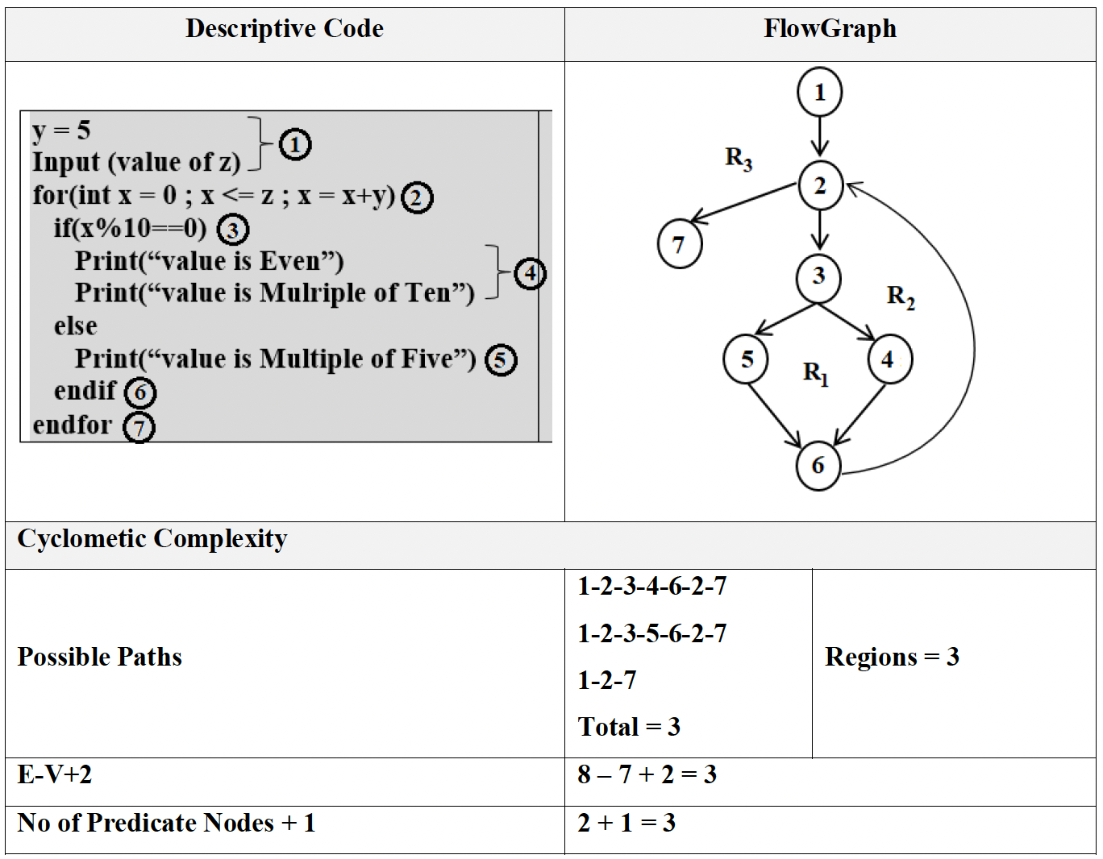
Methods used in WBT
Example-1:

Slide 128
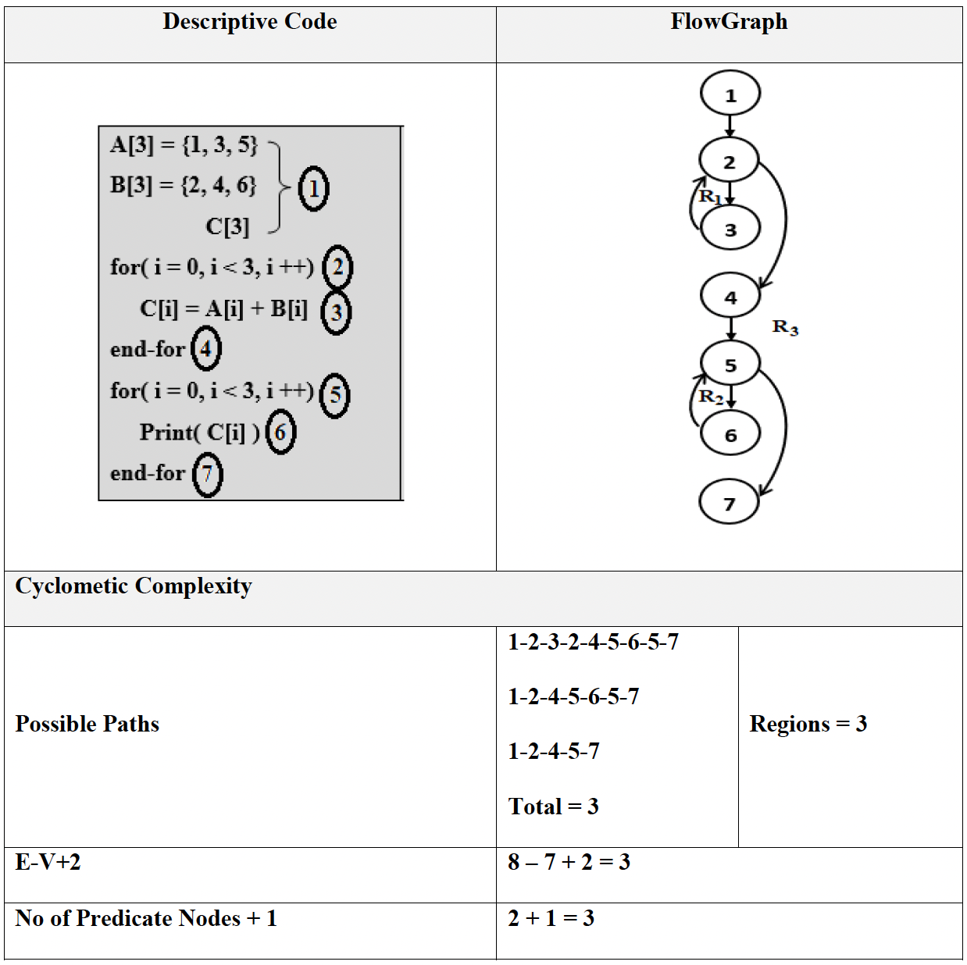
Methods used in WBT
Example-2

Slide 129
5.6 Software Maintenance
Modifying a program after it has been put into use.
The term is mostly used for changing custom software. Generic software products are said to evolve to create new versions.
Maintenance does not normally involve major changes to the system’s architecture.
Changes are implemented by modifying existing components and adding new components to the system.

Slide 130
5.7 Problems During Maintenance
Often the program is written by another person or group of persons.
Often the program is changed by person who did not understand it clearly.
Program listings are not structured.
High staff turnover.
Information gap.
Systems are not designed for change

Slide 131
5.8 Types of Maintenance
Maintenance to repair software faults
Changing a system to correct deficiencies in the way meets its requirements.
Maintenance to adapt software to a different operating environment
Changing a system so that it operates in a different environment (computer, OS, etc.) from its initial implementation.
Maintenance to add to or modify the system’s functionality
Modifying the system to satisfy new requirements.

Slide 132
5.9 Software Maintenance Process
Once particular maintenance objective is established, the maintenance personnel must first understand what they are to modify.
They must then modify the program to satisfy the maintenance objectives.
After modification, they must ensure that the modification does not affect other portions of the program.
Finally, the must test the program. These activities can be accomplished in the four phases as shown in Figure 8.2.
Figure 8.2: Software Maintenance Process

Slide 133
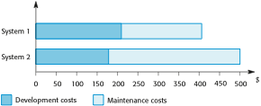
5.10 Maintenance Costs
Usually greater than development costs (2 to 100 times depending on the application).
Affected by both technical and non-technical factors.
Increases as software is maintained. Maintenance corrupts the software structure so makes further maintenance more difficult.
Ageing software can have high support costs (e.g. old languages, compilers etc.).
Development vs Maintenance Costs

Slide 134
5.10.1 Maintenance Cost Factors
Team stability
Maintenance costs are reduced if the same staff are involved with the organization.
Contractual responsibility
The developers of a system may have no contractual responsibility for maintenance so there is no incentive to design for future change.
Staff skills
Maintenance staff are often inexperienced and have limited domain knowledge.
Program age and structure
As programs age, their structure is degraded and they become harder to understand and change.

Slide 135
5.11 Maintenance Prediction
Maintenance prediction is concerned by identifying the parts of the system that may cause problems.
More and more changes degrades the system and reduces its maintainability.
Figure 8.4: Maintenance Prediction

Slide 136
5.12 Software Re-Engineering
Software re-engineering is concerned with taking existing legacy systems and re-implementing them to make them more maintainable without changing its functionality.
The critical distinction between re-engineering and new software development is the starting point for the development as shown in Figure 8.5.
Figure 8.5: Comparison of new software development with re-engineering

Slide 137
Software Re-Engineering
As a part of this re-engineering process, the system may be re-documented or restructured.
It may be translated to a more modern programming language, implemented on existing hardware technology. Thus software re-engineering allows translate source code to new language, restructured old code, migrate to a new platform (such as client-server), capture and then graphically display design information, and re-document poorly documented systems.
The cost of re-engineering depend on the extent of the work that is carried out. Other factors affecting costs are: the quality of the software, tool support available, extent of data conversion, availability of expert staff.
The alternative to re-engineering a software system is to develop that system using modern software engineering techniques. Where systems are very badly structured this may be the only viable option as the re-engineering costs for these systems are likely to be high.

Slide 138
5.12.1 Reengineering process activities
Source code translation
Convert code to a new language.
Reverse engineering
Analyse the program to understand it;
Program structure improvement
Restructure automatically for understandability;
Program modularisation
Reorganise the program structure;
Data reengineering
Clean-up and restructure system data.

Slide 139
5.12.2 Advantages of Re-Engineering
Reduced risk
There is a high risk in new software development. There may be development problems, staffing problems and specification problems.
Reduced cost
The cost of re-engineering is often significantly less than the costs of developing new software.
5.12.3 Reengineering cost factors
The quality of the software to be reengineered.
The tool support available for reengineering.
The extent of the data conversion which is required.
The availability of expert staff for reengineering.

Slide 140
Key Points
software application needs to be verified as well as validated for a successful deployment.
Testing is the process of executing a program with the intent of finding errors.
Stages of Testing-Development testing, Release testing and User testing
Black-box testing, also called behavioral testing, focuses on the functional requirements of the software.
White-box testing also called glass-box testing. In WBT test cases are designed using the control structure of the procedural design.

Slide 141
Key Points
There are 3 types of software maintenance, namely bug fixing, modifying software to work in a new environment, and implementing new or changed requirements.
Software re-engineering is concerned with re-structuring and re-documenting software to make it easier to understand and change.
The business value of a legacy system and the quality of the application should be assessed to help decide if a system should be replaced, transformed or maintained.

Slide 142
Review questions
Differentiate between software verification and software validation.
Write short notes on the different stages of testing
What are the different types of user testing
Explain in detail about BBT(Black Box Testing)
What is meant by cyclomatic complexity?
List down the problems happened during maintenance
What are the different types of maintenance?
Illustrate software maintenance process with neat diagram
List down the factors that affects the maintenance cost.

Slide 143
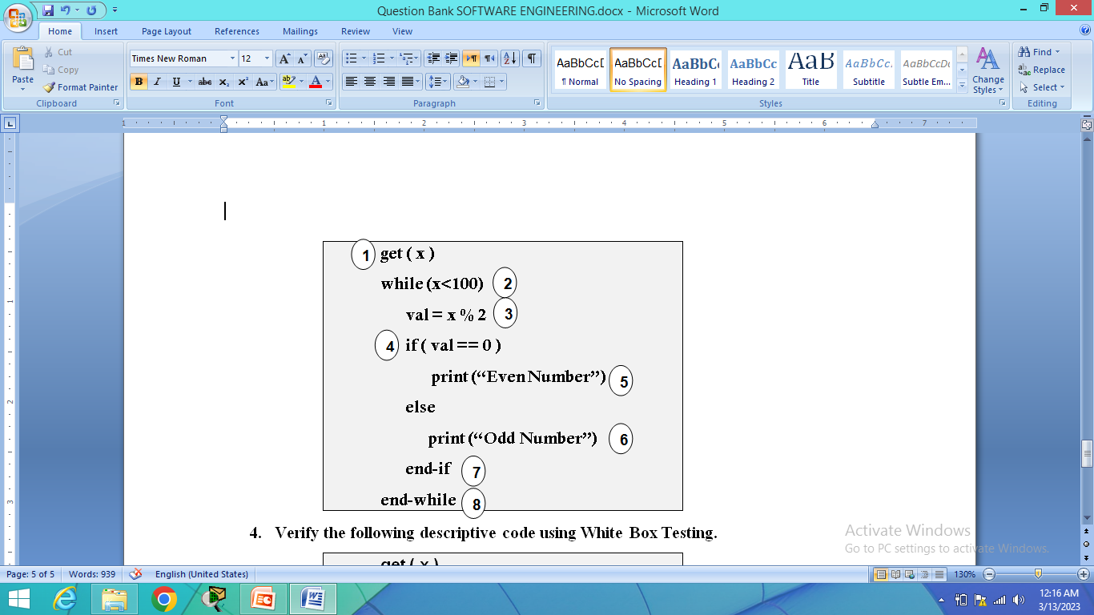
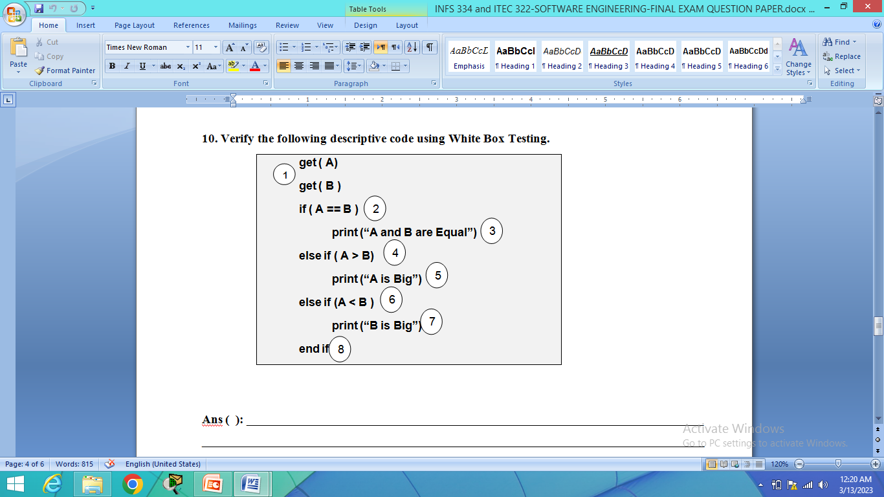
Review questions
10. Write short notes on Maintenance prediction
11. What is meant by software reengineering. List down its advantage.
12. List the activities of Reengineering process.
13. Verify the following descriptive code using White Box Testing.
(a) (b)

Slide 144
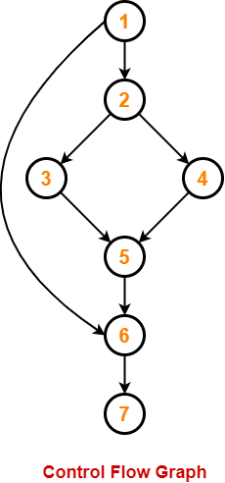
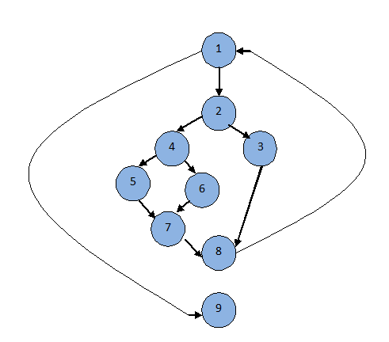
Review questions
14. Calculate cyclomatic complexity using all methods for the given control flow graph.
(a) (b)

